Slide 1
CURENT Large-scale Testbed (LTB)
Weekly Meeting
09/14/2026
CURENT, University of Tennessee, Knoxville
Leadership Team | Dr. Fran Li
Senior Advisor | Dr. Kevin Tomsovic, Dr. Hantao Cui, Dr. Xin Fang
Core Development | Dr. Hantao Cui, Dr. Xin Fang, Dr. Jinning Wang, Nicholas Parsly, Nick West, Zack Malkmus, Junjie Yin, Matthew Cannavaro, Hank Lin
Other Contributors | Dr. Qiwei Zhang, Dr. Buxin She, Dr. Hang Shuai

Slide 2
1. Summary
Community
Homepage: https://ltb.curent.org/
LinkedIn: https://www.linkedin.com/company/76122605
YouTube: https://www.youtube.com/@curentltb
GitHub: https://github.com/CURENT
Admin:
Development
LLM with LTB AMS
    Revise the optimization problem formulation
    How to verify or benchmark?
    Question design for target users
LLM with LTB Andes

Slide 3
Revise the optimization problem formulation
Implemented route: formulate now handles bounded structural edits separately from physical parameter changes.
Structured schema: FormulationEdit captures the target generator, IBR available power, dispatch cost, and curtailment cost.
Deterministic compiler: the LLM selects a reviewed template; fixed code adds variables, constraints, bus mapping, and objective terms.
Current scope: replace one generator with a steady-state IBR in DCOPF/DCOPF2. Dynamic controls and reactive-power models remain future templates.

Slide 4
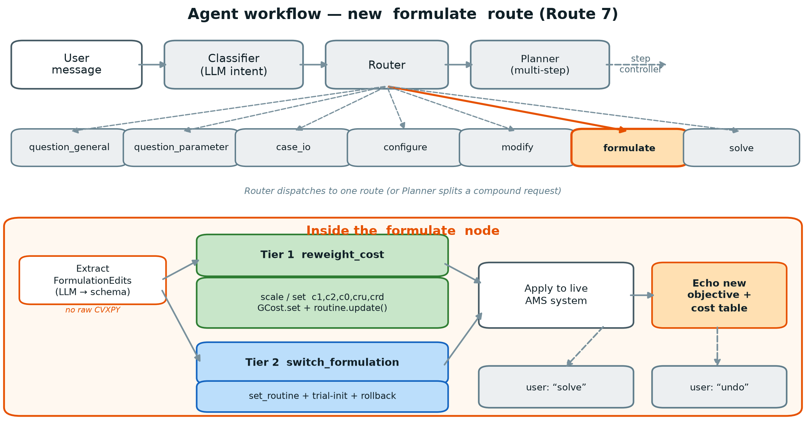
Revise the optimization problem formulation
Implemented workflow: the formulate route

Slide 5
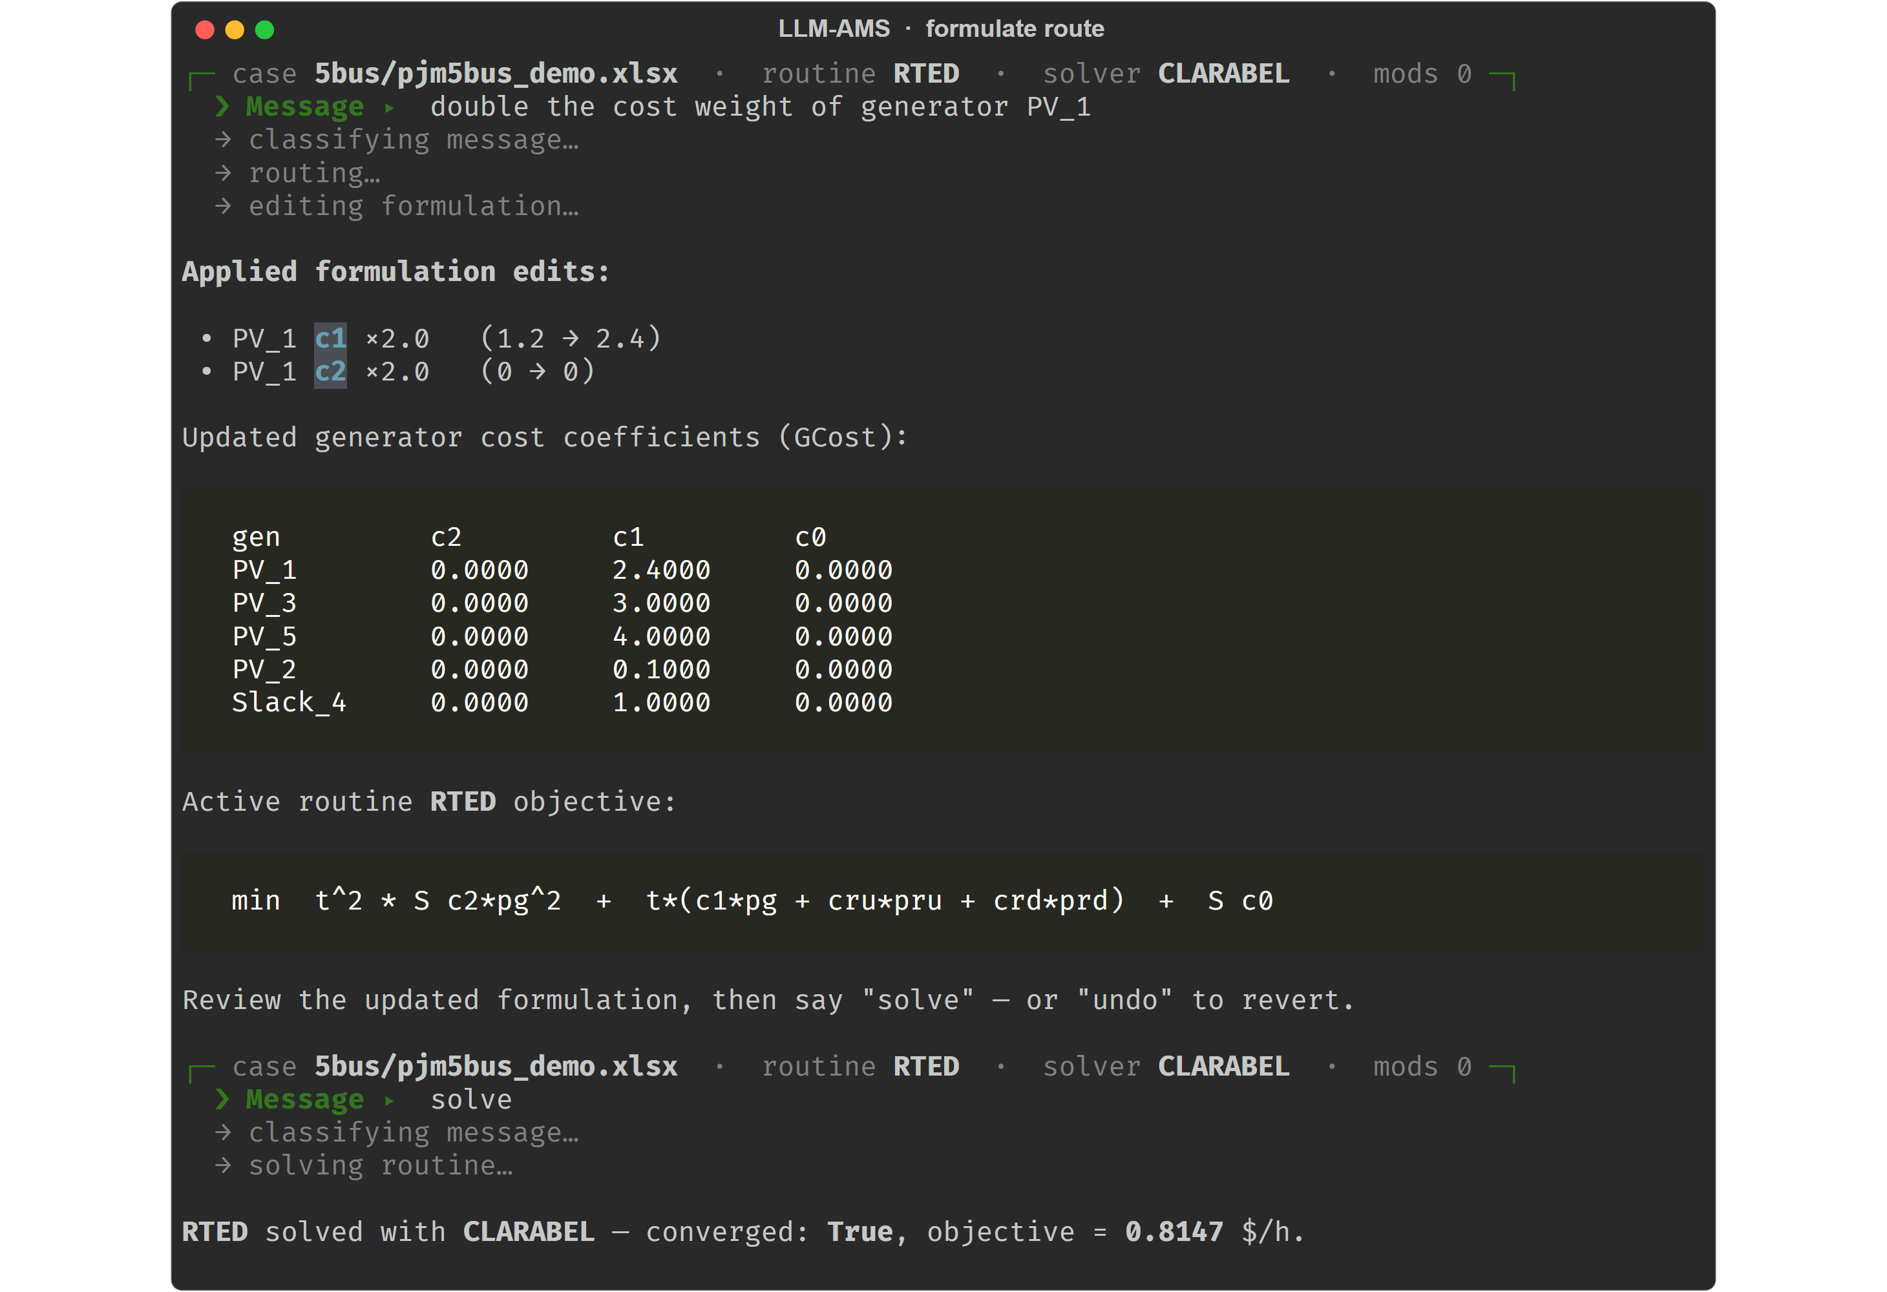
Revise the optimization problem formulation
Baseline limitation: cost reweighting changes parameters, not model structure

Slide 6
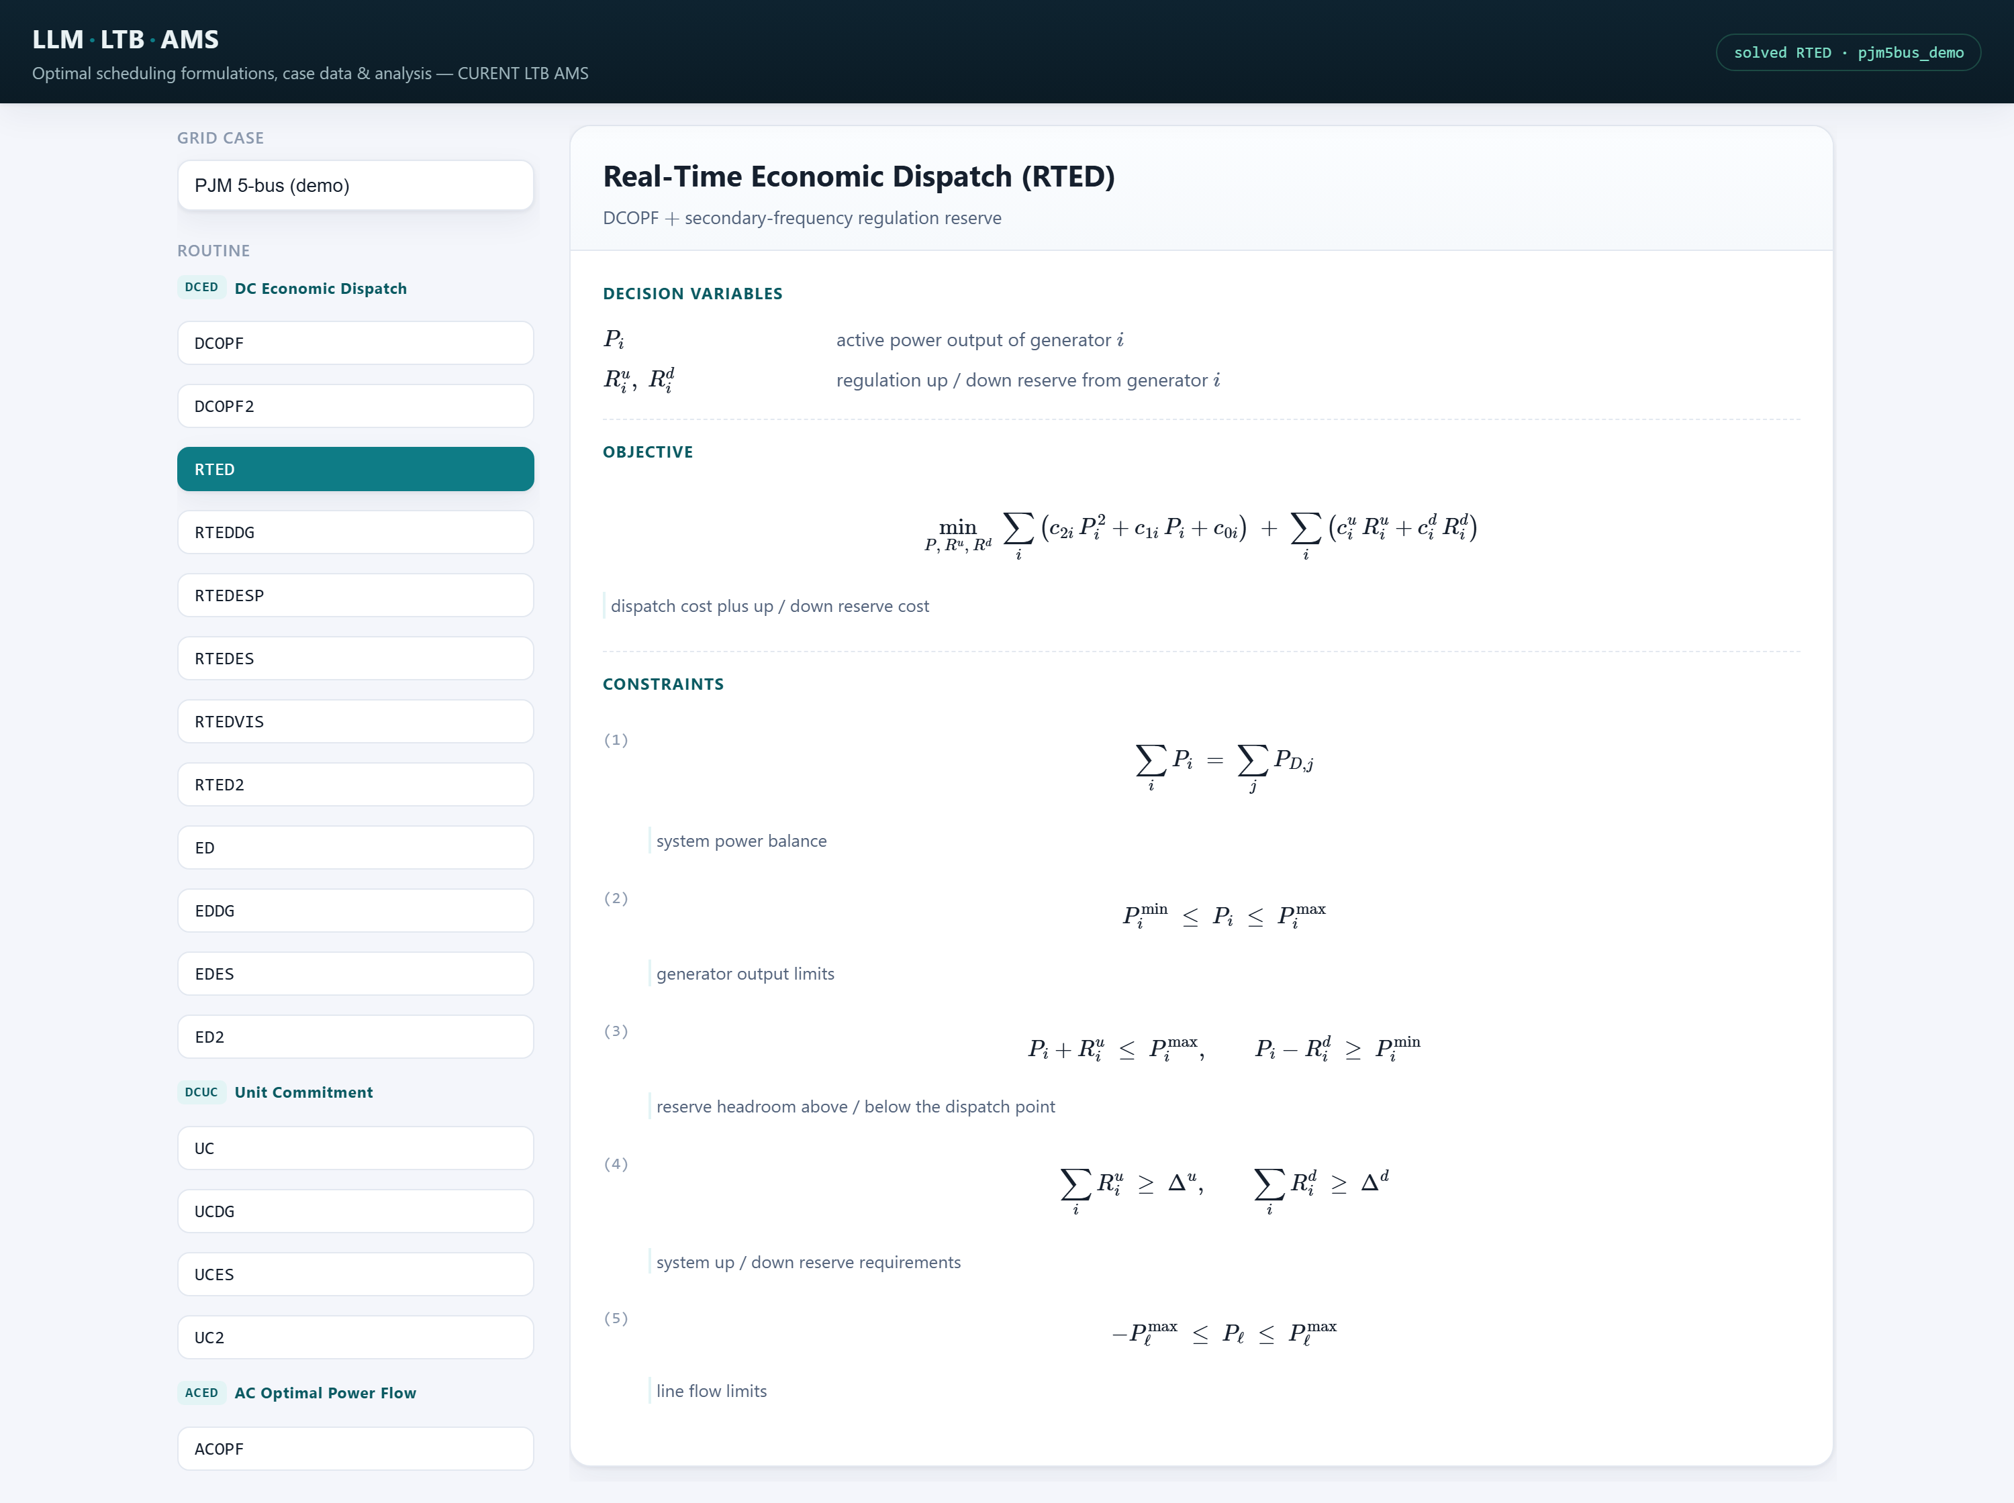
Revise the optimization problem formulation
Formulation review: variables, constraints, objective terms, and assumptions

Slide 7
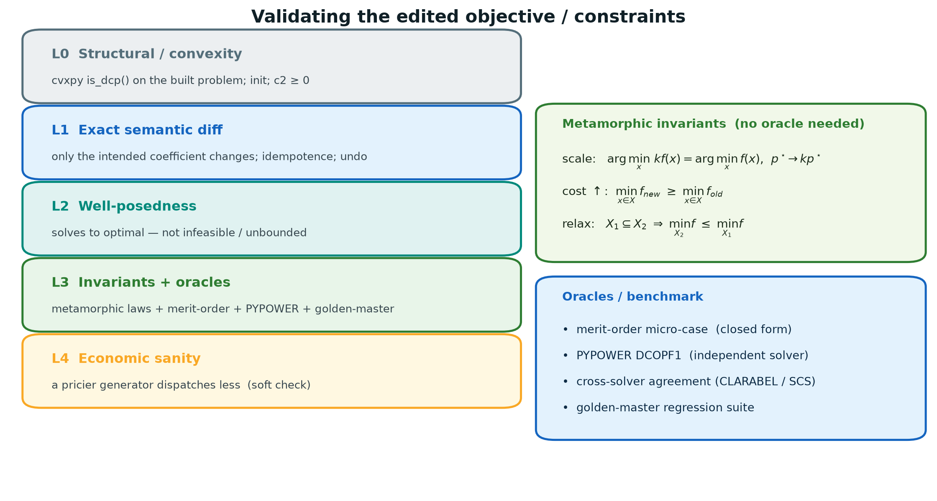
How to verify or benchmark?

Slide 8
How to verify or benchmark?
Compiler validation: 9 / 9 deterministic checks pass
1 Schema: valid IBR specification accepted
2 Capacity guard: zero or negative capacity rejected
3 Cost guard: negative cost rejected
4 Template contract: structural components declared
5 Device replacement: only the selected generator disabled
6 Bus mapping: IBR connected at the replaced unit's bus
7 Variables: pibr and pcurt added as nonnegative variables
8 Constraints: availability and nodal injection added
9 Objective and DCP: both cost terms added; convexity gate passed
Scope: compiler contract verified; live AMS solve remains pending on this machine due to its kvxopt binary.

Slide 9
How to verify or benchmark?
Layered verification: check user intent, formulation, implementation, and solution feasibility or optimality.
New benchmarks: combine expert-reviewed components, hand-solvable cases, and mathematical property tests.
Verifier evaluation: inject missing constraints, sign errors, and incorrect device mappings; add cross-tool comparisons and expert review.

Slide 10
Question design for target users
Target users: researchers and planners who understand study goals but may not know dataset or optimization implementation details.
Intent-based prompts: users state goals and constraints; the system clarifies missing inputs and constructs the study.
Development direction: requirement clarification, modeling, verification, and interpretation, with clear limits on real-world conclusions.

Slide 11
















Acknowledgements
Contributors:
Users:
Acknowledgements:
Notes:
Two layers: Contributors and users
MSU as a user

